Slide 1
Feature Engineering
LECTURE
Introducing Feature Engineering
Sean Kang

Slide 2
What is Feature Engineering
Process of extracting useful features from raw data using math, statistics, or domain knowledge
There are some automated tools to detect those meaningful data

Slide 3
Why is Feature Engineering Important
To make our model more sophisticated to handle more complex data.
Better understanding of underlying data
Faster processing

Slide 4
What can we create
We can create feature X data from
Quantitative data
Categorical data
Text data

Slide 5
Feature Engineering Outlier Detection

Slide 6
Outlier Detection Some data that is very different from most of the data. Some of the data is real but there are chances that they are errors. Removing or fixing the data can improve the model creation. * ie. Human age, 1000 years old Methods: statistical: percentage, standard deviations, visual.
Notes:
3 step modelling process: defining a model, defining a loss function, minimizing avg loss to fit our model to the data
Looked at constant model: theta as single scalar value, parameters defines predictions our model makes
Loss functions tell us how good or bad a single prediction was for one observation in our dataset
If y-hat is close to the true value our loss will be low, otherwise it will be high
Want model that best fits entire dataset NOT just a single observation
Minimize avg loss across entire dataset to find the model the best fits the data

Slide 7
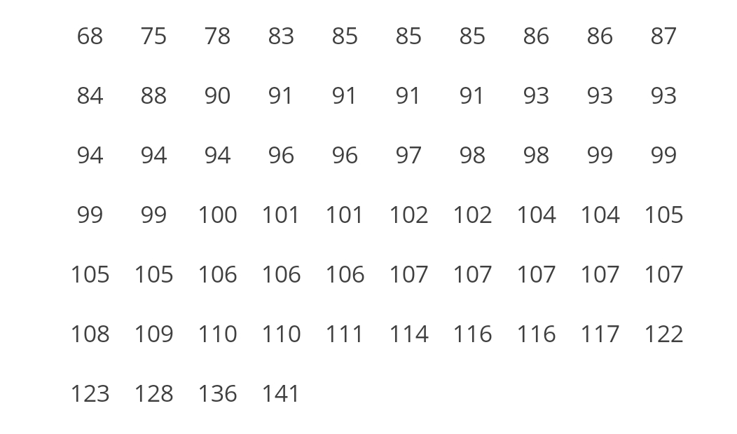
What is Percentile?
This is different from percent
These are IQ values. How to determine the 25 percentile, 75 percentile, etc.
Looking at 0 and 100 would locate some outliers.

Slide 8
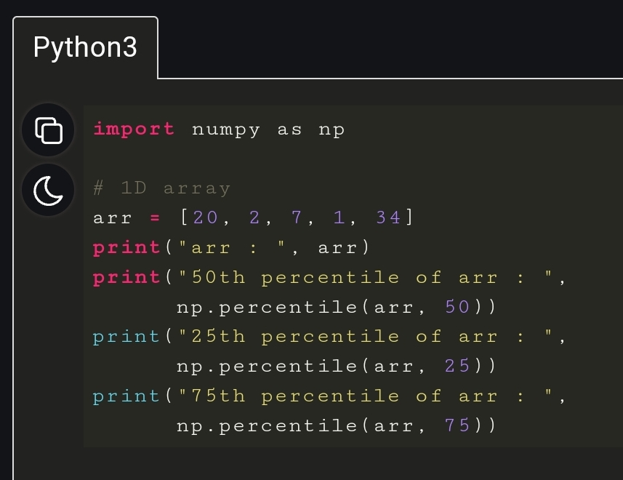
How to do it in Python Numpy

Slide 9
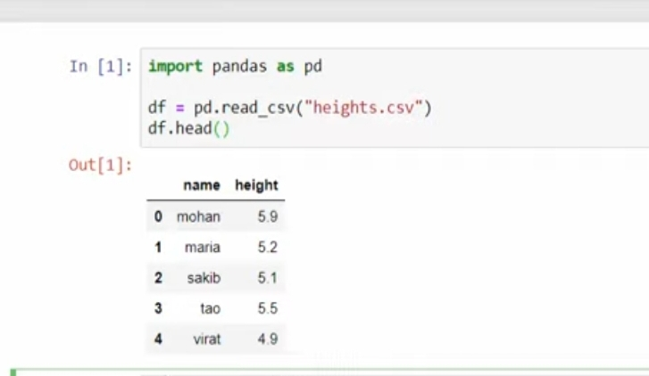
Using Data frame with Percentile (demo)

Slide 10
Another Technique: One hot encoding

Slide 11
Building a matrix of on and off values
The US, Japan, europe mpg dataset.
Two approaches:
Pandas
SciKit Learn

Slide 12
Handling Missing Values
Using mean values for that column -- horsepower

Slide 13
Revisit: Multiple linear regression

Slide 14
Terminology
There are several equivalent terms in the regression context. You should be aware of them.
Feature.
Covariate.
Independent variable.
Explanatory variable.
Predictor.
Input.
Regressor.
Output.
Outcome.
Response.
Dependent variable.
x
y

Slide 15
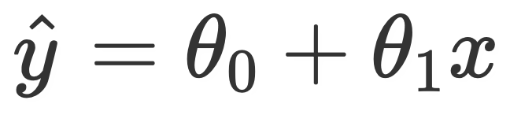


Adding independent variables
First, some terminology. For our purposes, all of these terms mean the same thing:
Feature.
Covariate.
Independent variable.
Explanatory variable.
Predictor.
Input.
Regressor.
In the regression context, each of the above things has a “weight” assigned to it, given by the parameter. We also call these weights “coefficients.” For instance, in , we might say the “weight” associated with the constant/intercept term is , and the “weight” associated with the x term is .

Slide 16

Multiple linear regression
Model 1:
Model 2:
These are different models! In general, in one model will not be equal to in another model.
2.4 is the slope of the relationship between AST and PTS, when only considering those two variables.
Parameters [3.98, 2.4] minimize average squared loss for Model 1.
1.64 is the slope of the relationship between AST and PTS, when also considering 3PA.
Parameters [2.163, 1.64, 1.26] minimize average squared loss for Model 2.
different!

Slide 17
Summary

Slide 18
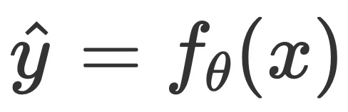
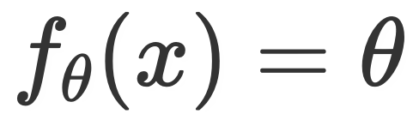
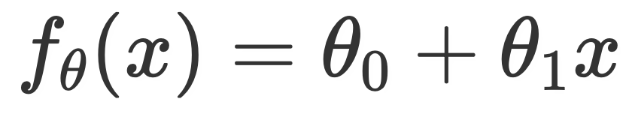
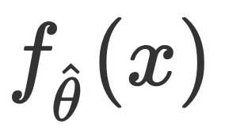
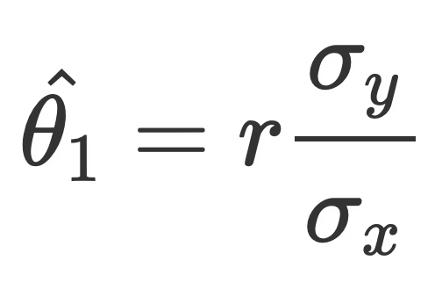
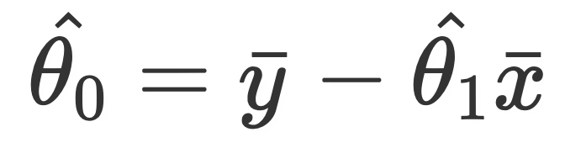
Summary
We now know of three models, .
The constant model, .
The simple linear regression model .
The multiple linear regression model .
A model with optimal parameters is denoted .
We looked at the correlation coefficient, r, and studied its properties.
We solved for the optimal parameters for the simple linear model by hand and by code, by minimizing average squared loss (MSE).
We introduced the notion of a feature, and how we can have multiple in our models.
We discussed the multiple R² coefficient and RMSE as methods of evaluating the quality of a linear model.

